Slide 1
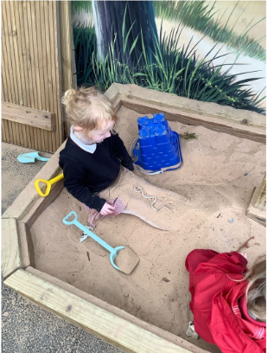
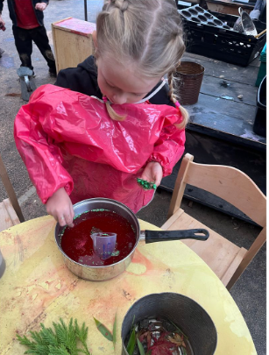
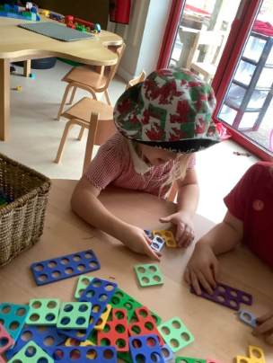
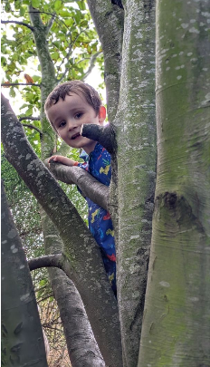
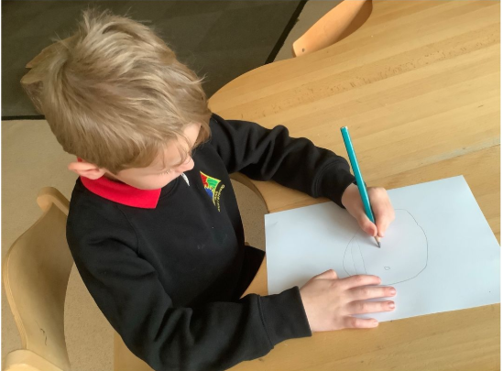
Open Afternoon for EE and Nursery pupils 2027
Thursday 15th October 2026
4:15pm-5:00pm
Ysgol Maes-y-Mynydd, Rhos, Wrexham. LL14 1DD
Come and visit our beautiful Early Years Provision and see what we have to offer for your child.
Please call 01978 832970 to register your interest in attending.
Will your child be ready for EE or Nursery in September 2027?
Applications can be made via Wrexham County Borough Council- closing dates for applications below..
EE January 2027-23rd October,
EE April 2027-18th December,
Nursery applications open 5th January 2027-close 15th February 2027

