Slide 1
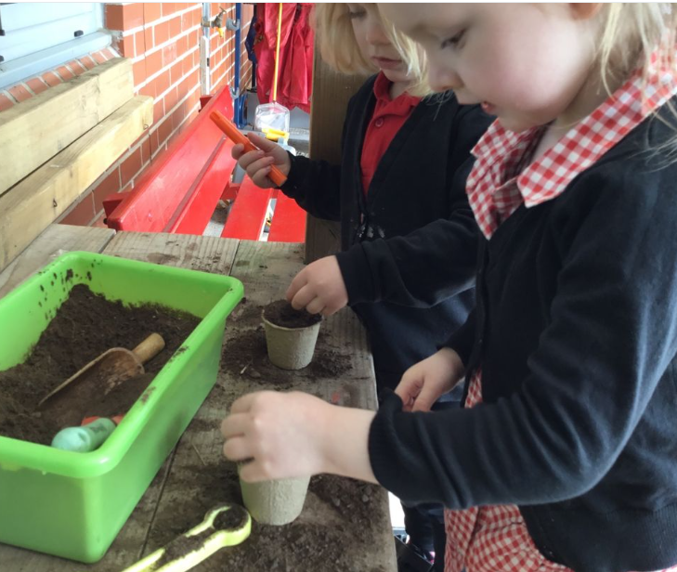
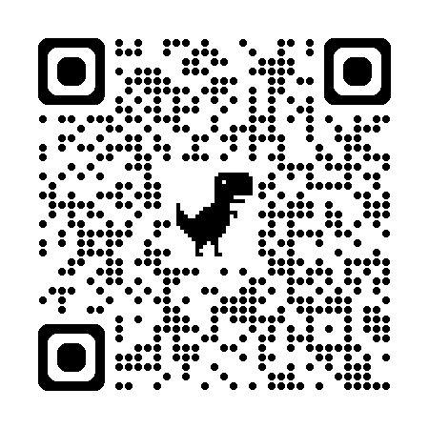

Open afternoon invite!
Is your child 3 before 31st December 2025?
Full-time wraparound care available through our All Stars provider.
If 'yes' they are ready for Early Education!
Ysgol Maes-y-Mynydd would love to meet new parents and children who are ready to choose their Early Education nursery place.
Scan below for our latest Estyn report.
Thursday 16th October 2025
2:00pm-2:40pm
Please contact the school office for more details.
Ysgol Maes-y-Mynydd, Rhos, LL141DD 01978 832970
Mailbox@maesymynydd-pri.Wrexham.sch.uk

